Slide 1
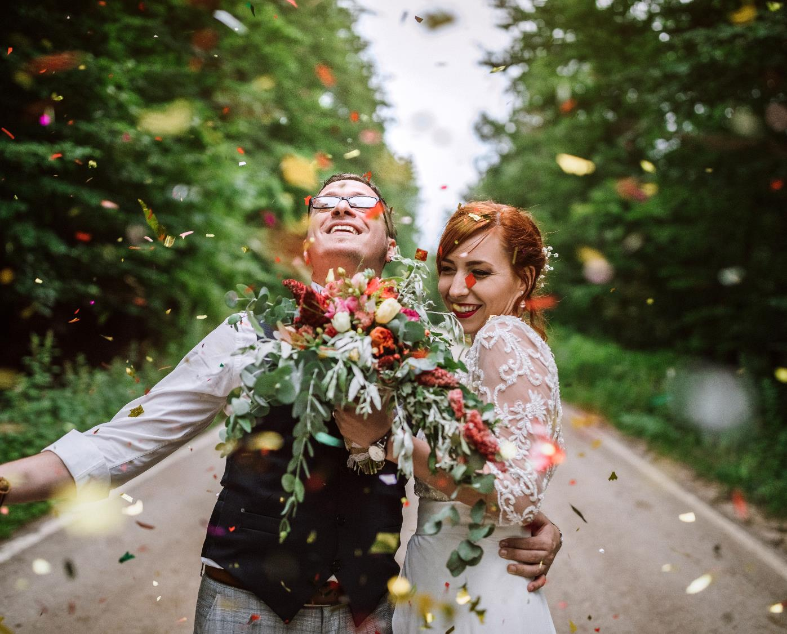
Title Slide Option 1
wedding of
The
and
Mira Persson
Kalle Astrom

Slide 2
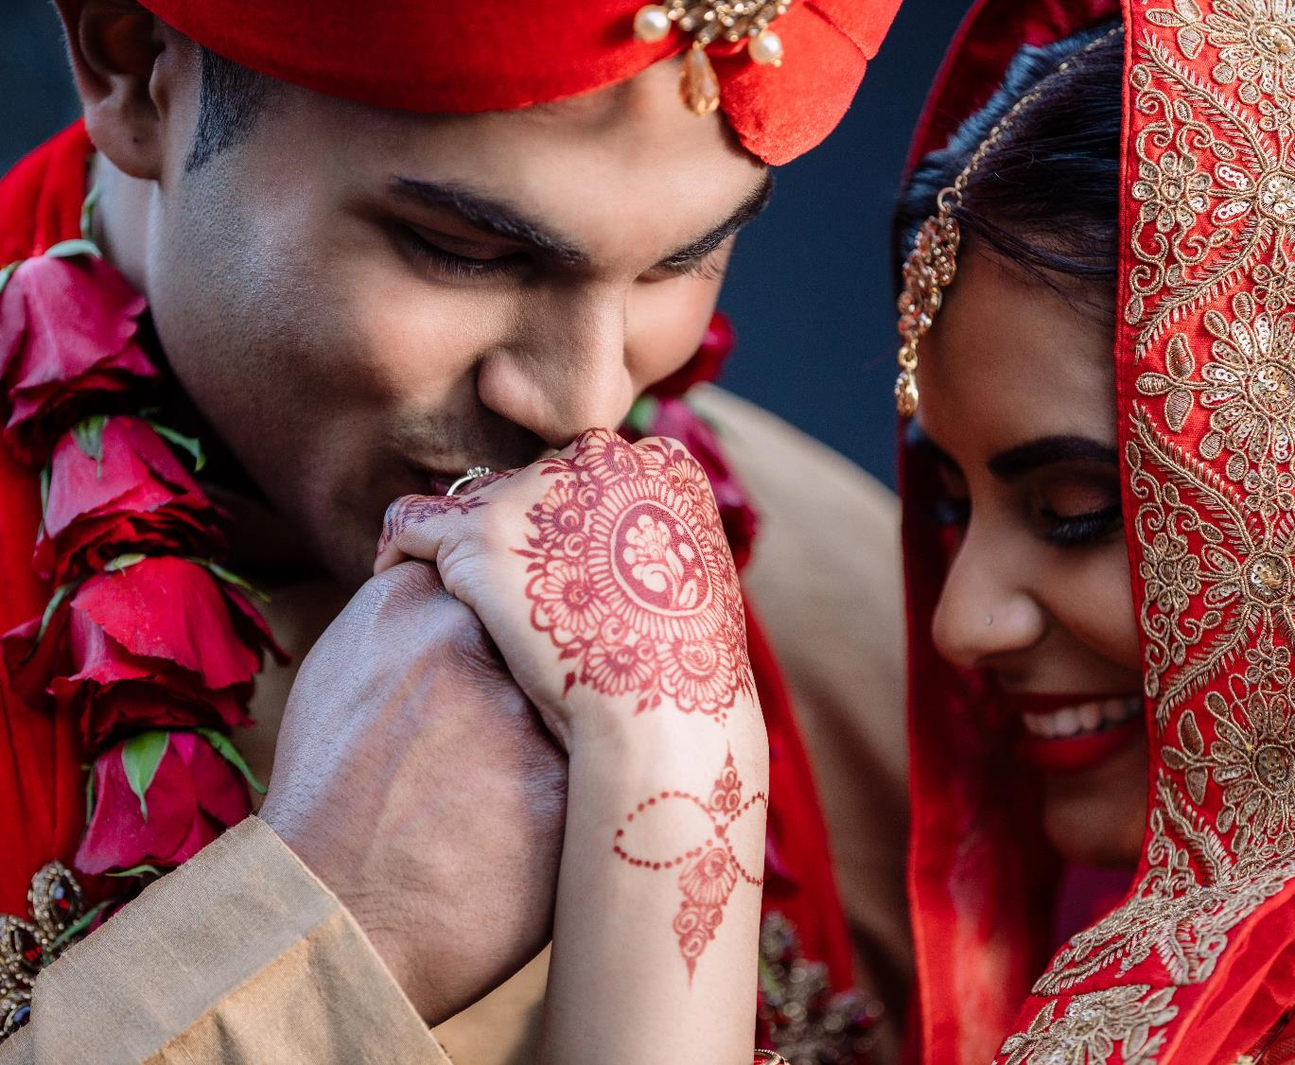
Title Slide Option 2
wedding of
The
and
Mira Persson
Kalle Astrom

Slide 3
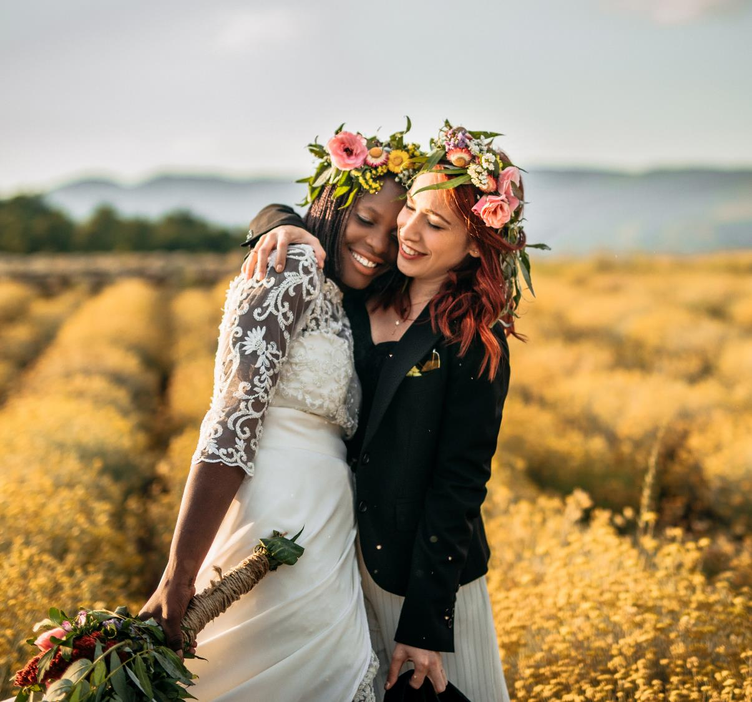
Title Slide Option 3
wedding of
The
and
Mira Persson
Kalle Astrom

Slide 4
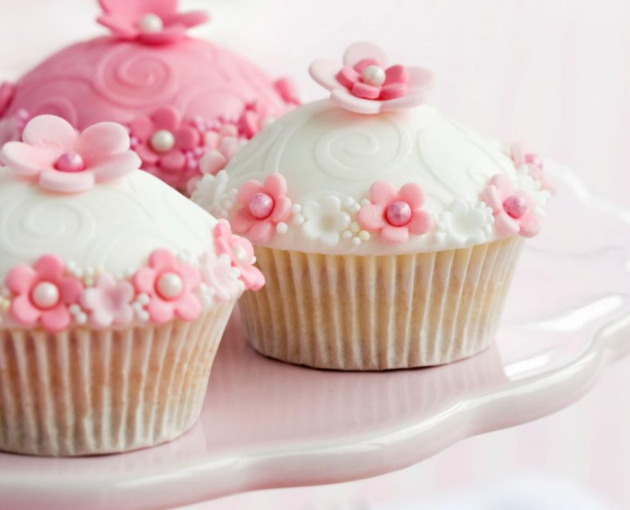
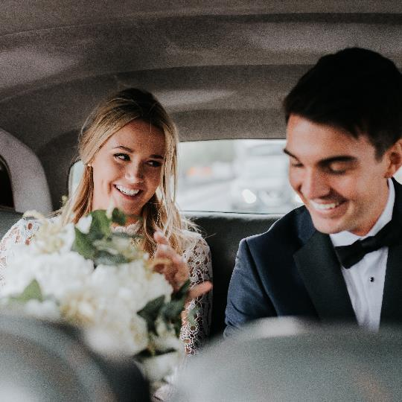
2 Images Option 1
Kalle Astrom
Mira Persson

Slide 5
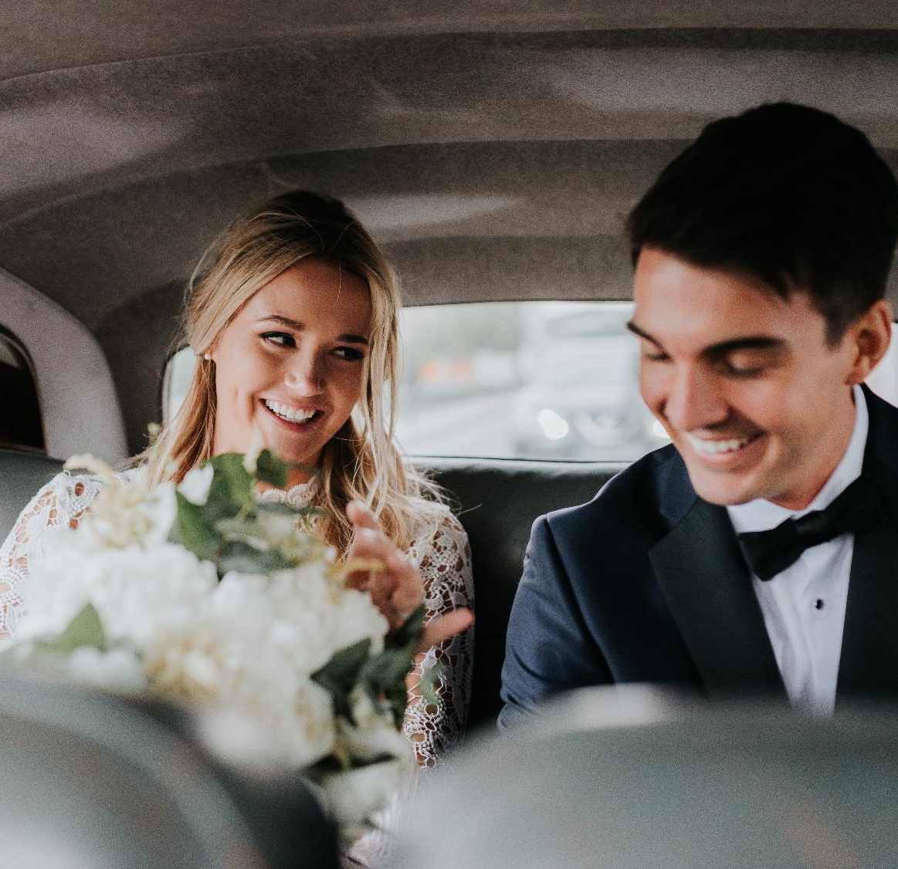
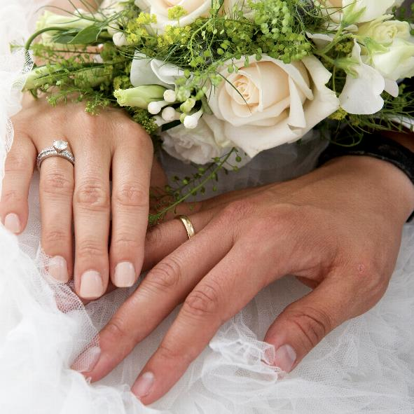
2 Images Option 2
and
Mira Persson
Kalle Astrom

Slide 6
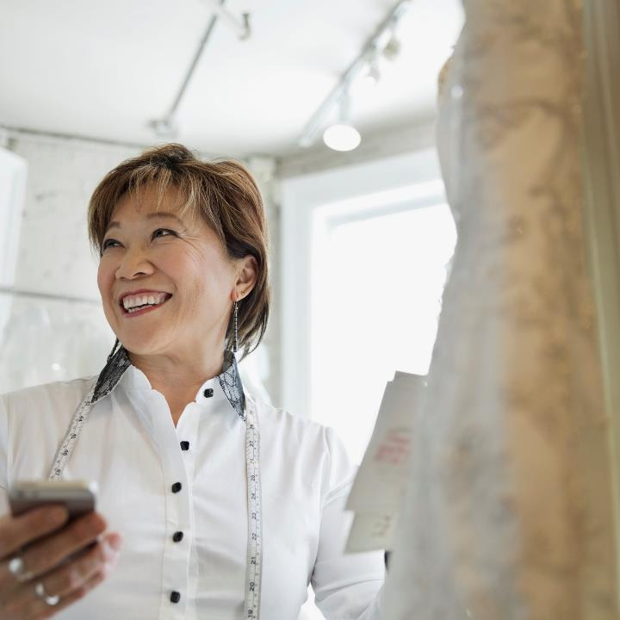
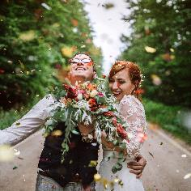
2 Images Option 3
wedding of
The
and
Mira Persson
Kalle Astrom

Slide 7
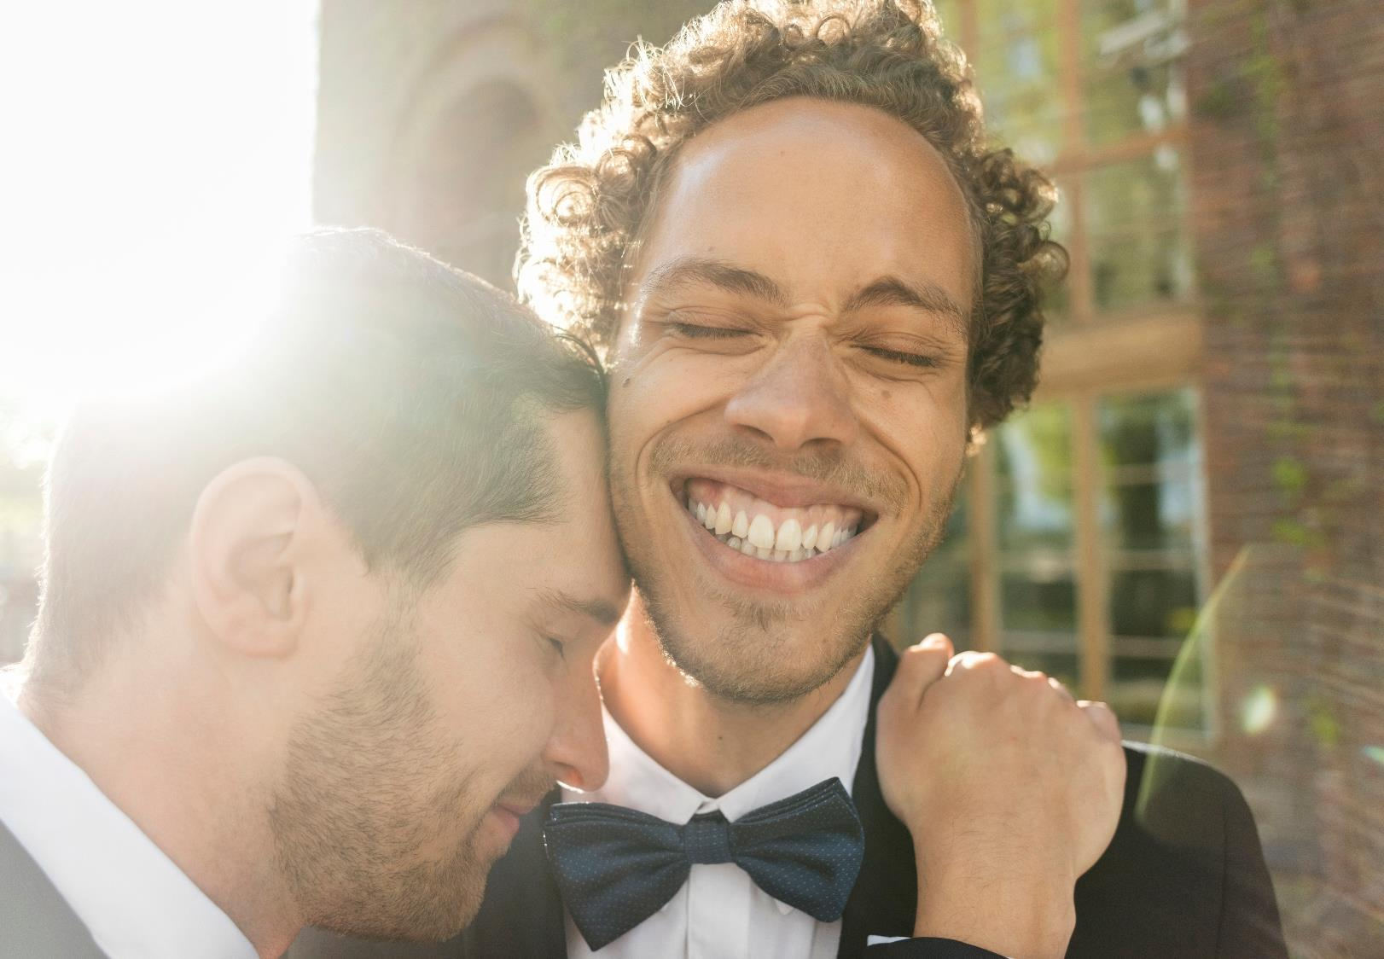
Fullscreen Image Option 5
and
Mira Persson
Kalle Astrom

Slide 8
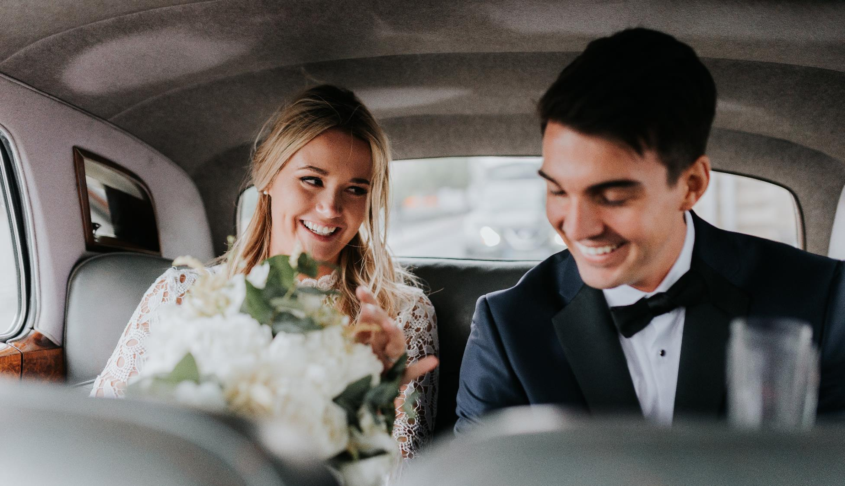
Fullscreen Image Option 4

Slide 9
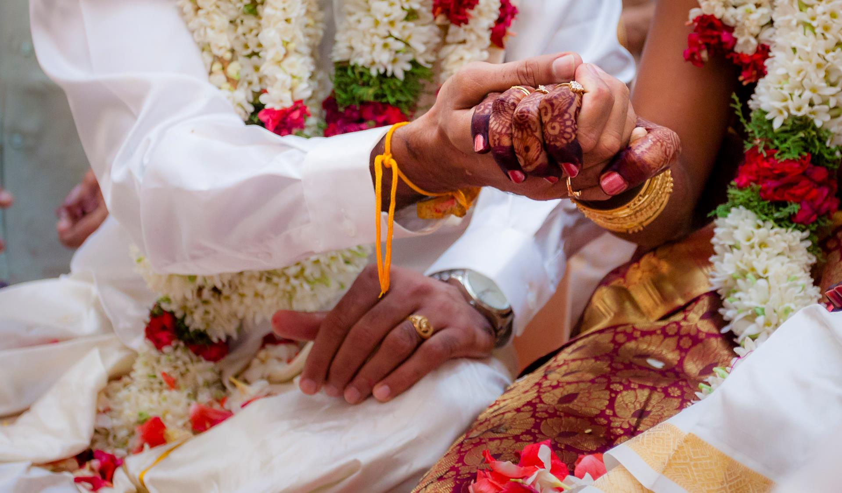
Fullscreen Image Option 3

Slide 10
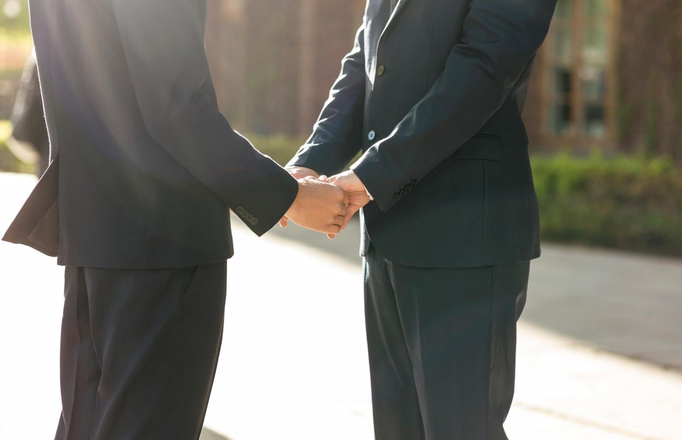
Fullscreen Image Option 2

Slide 11
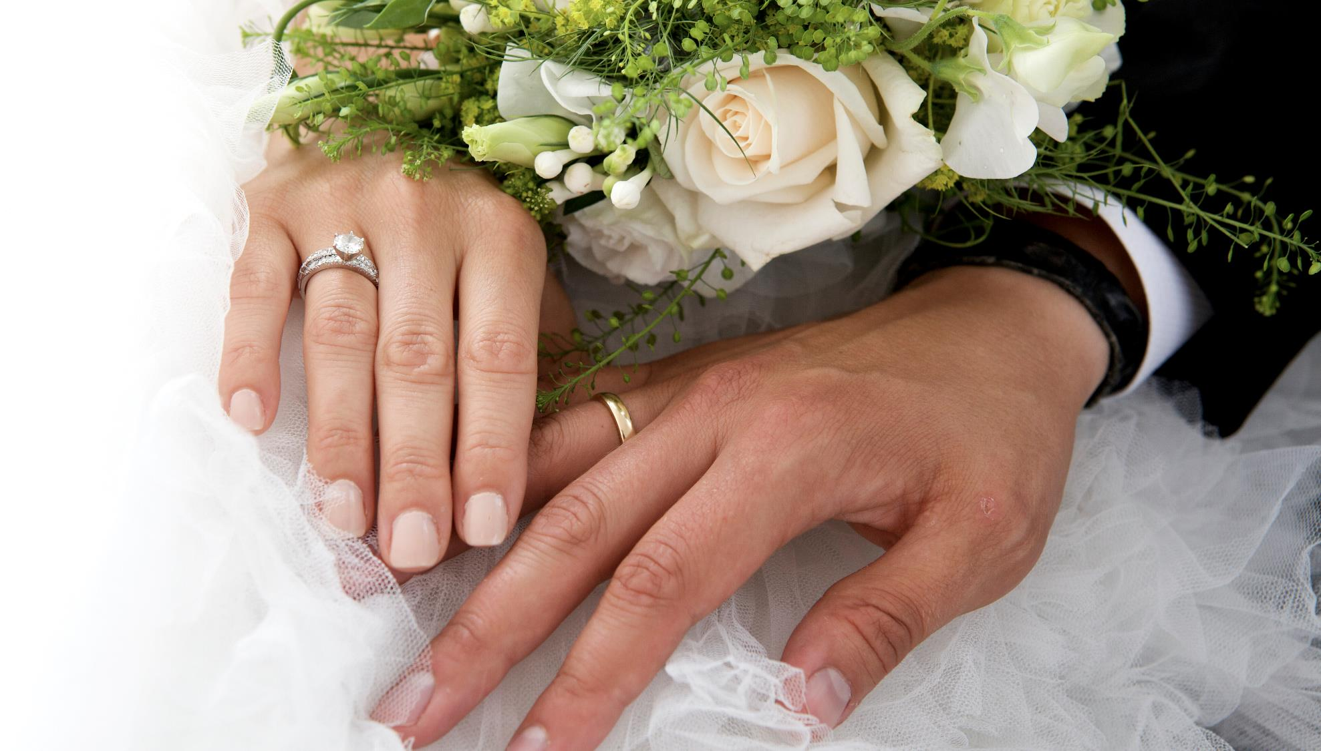
Fullscreen Image Option 1

Slide 12
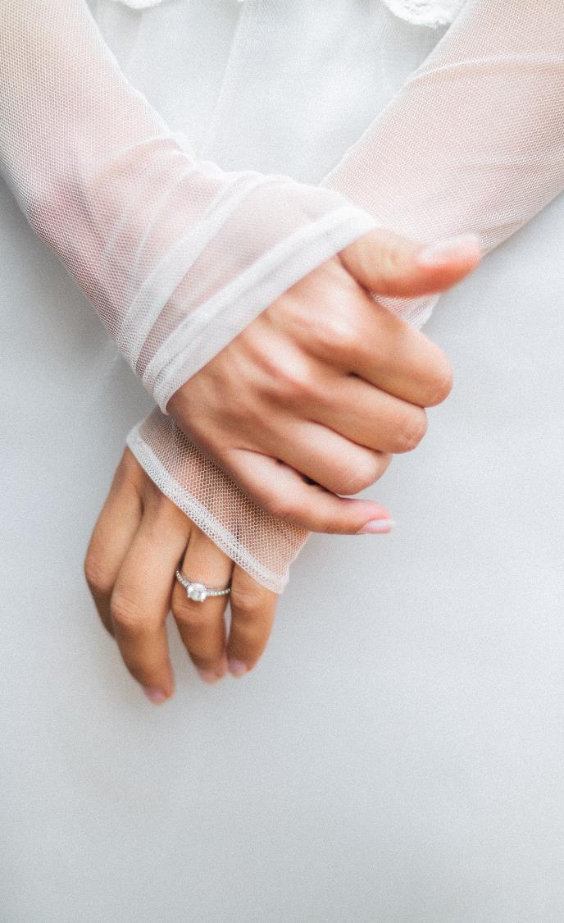
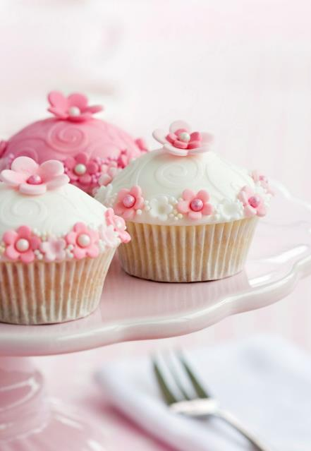
3 X Images Option 1
Kalle Astrom
Mira Persson

Slide 13
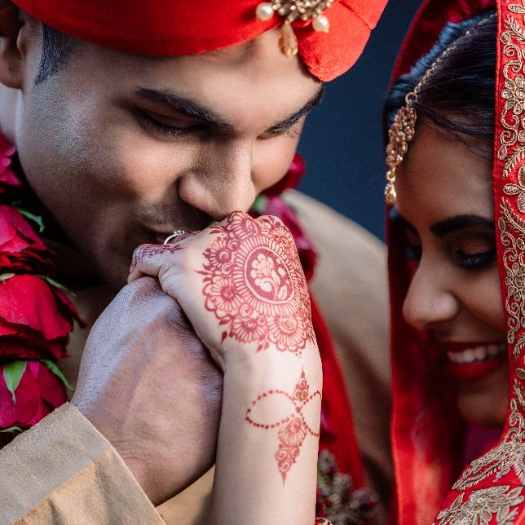
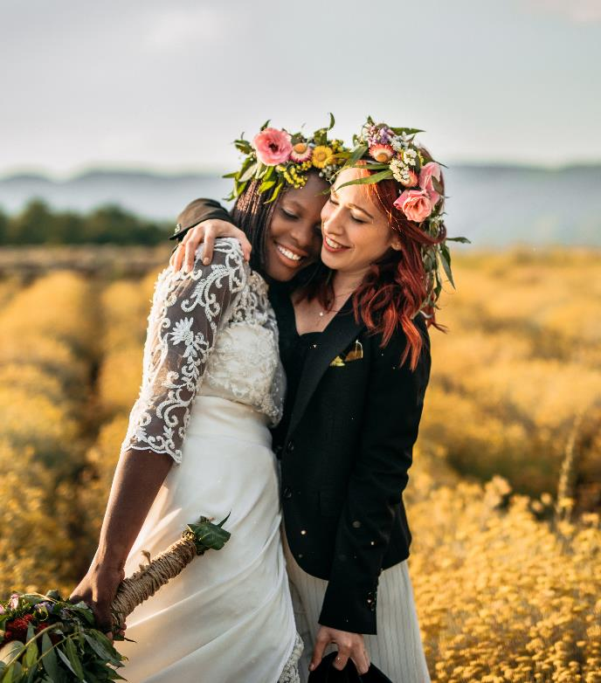
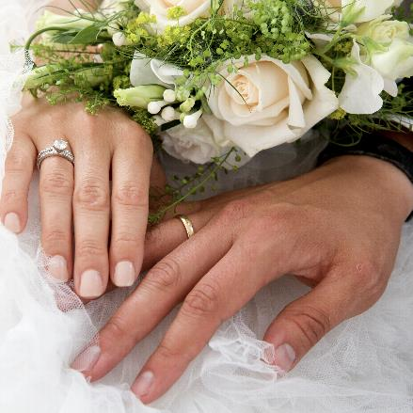
3 X Images Option 2
and
Mira Persson
Kalle Astrom

Slide 14
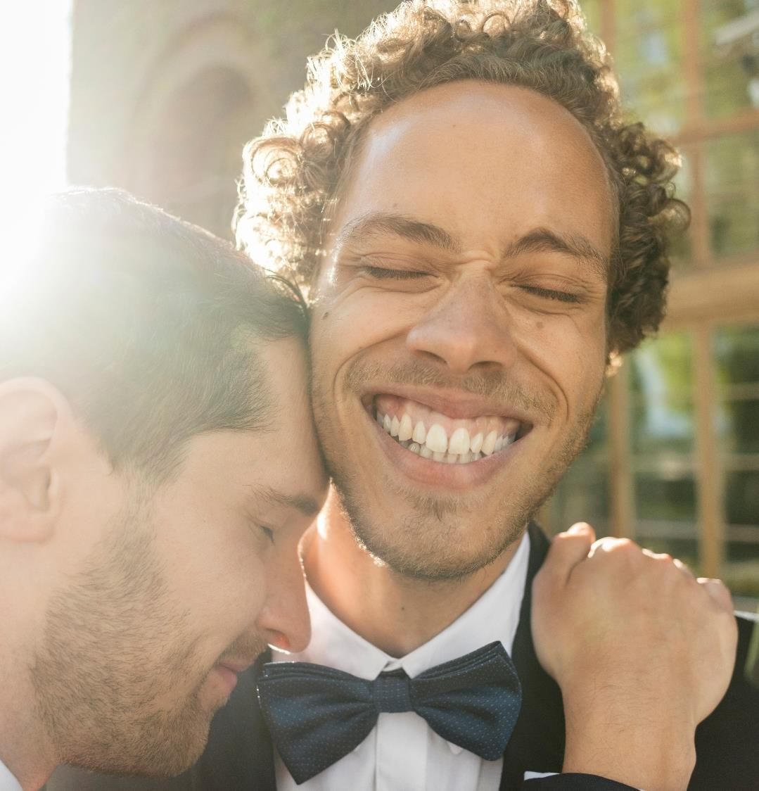

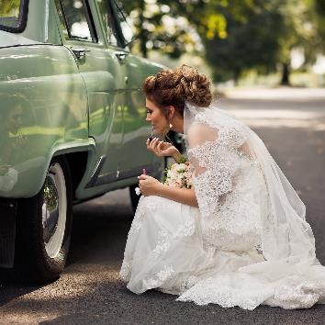
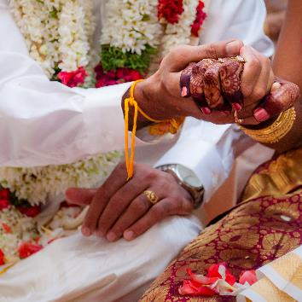
4 X Images Option 1
and
Mira Persson
Kalle Astrom

Slide 15
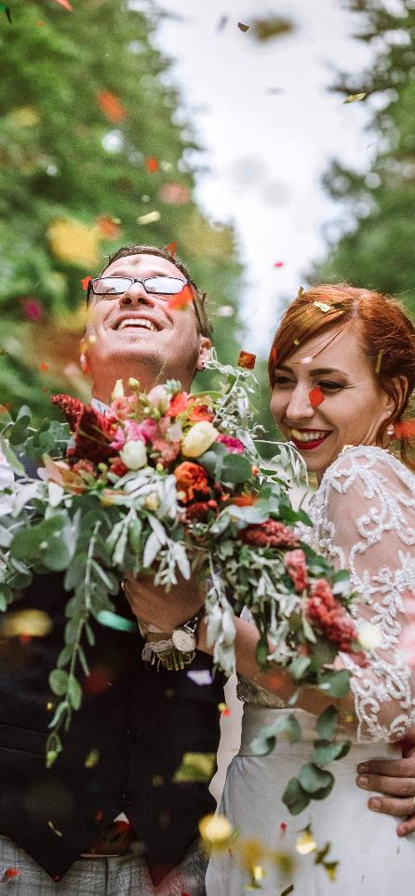
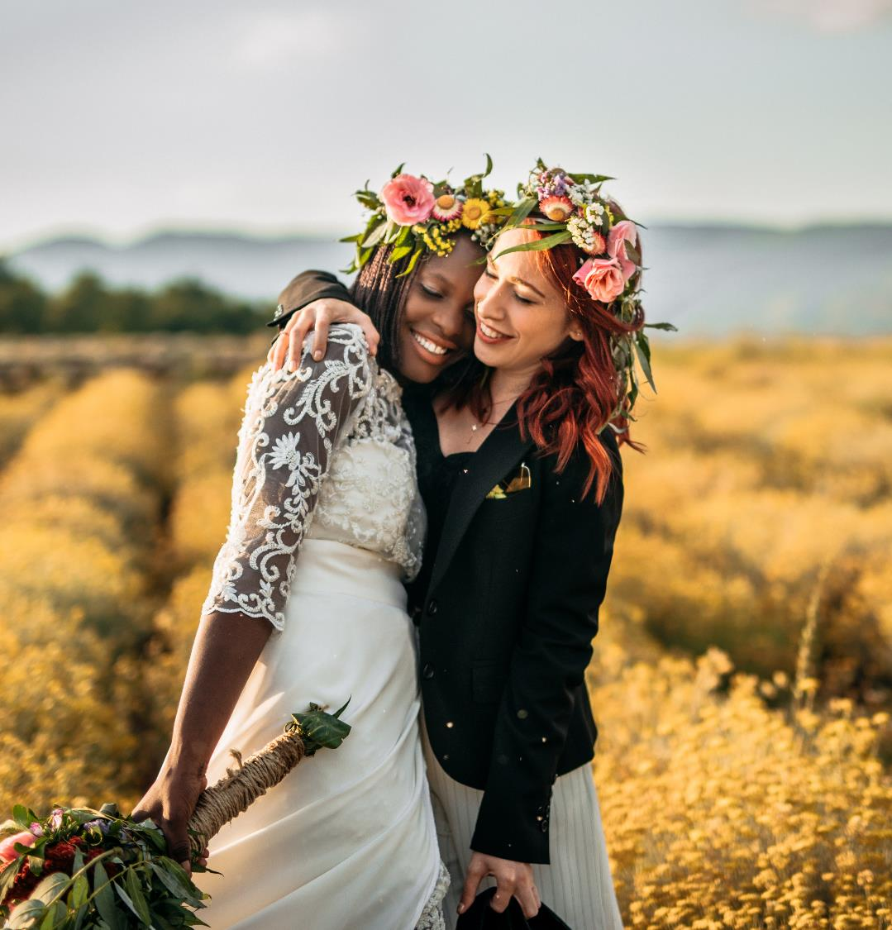
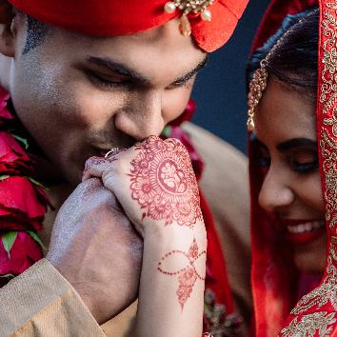

4 X Images Option 2
and
Mira Persson
Kalle Astrom

Slide 16
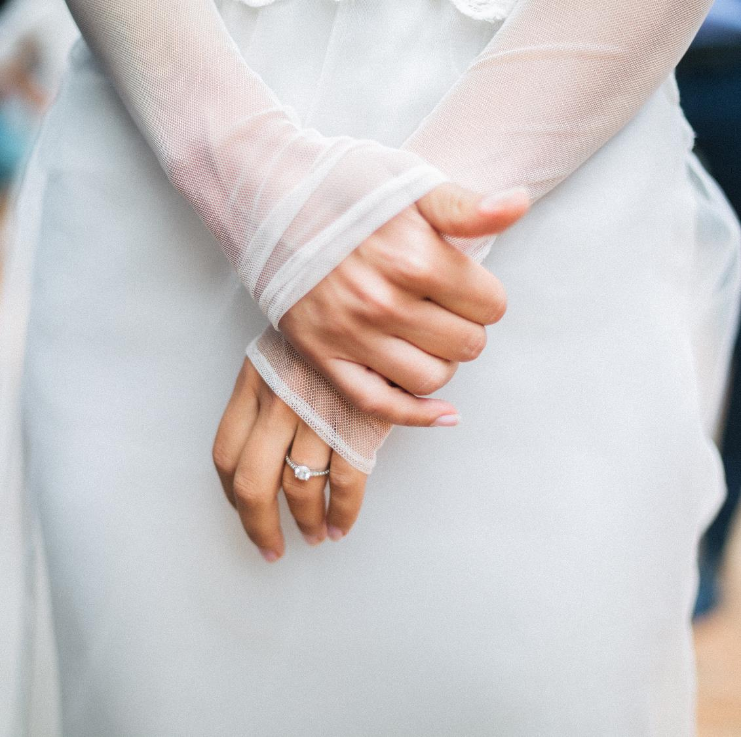
First look with the bride
Slow down on the big day and make time for a special moment between you and your partner. One way to do this is to plan a “first look” meeting just before the ceremony begins.

Slide 17
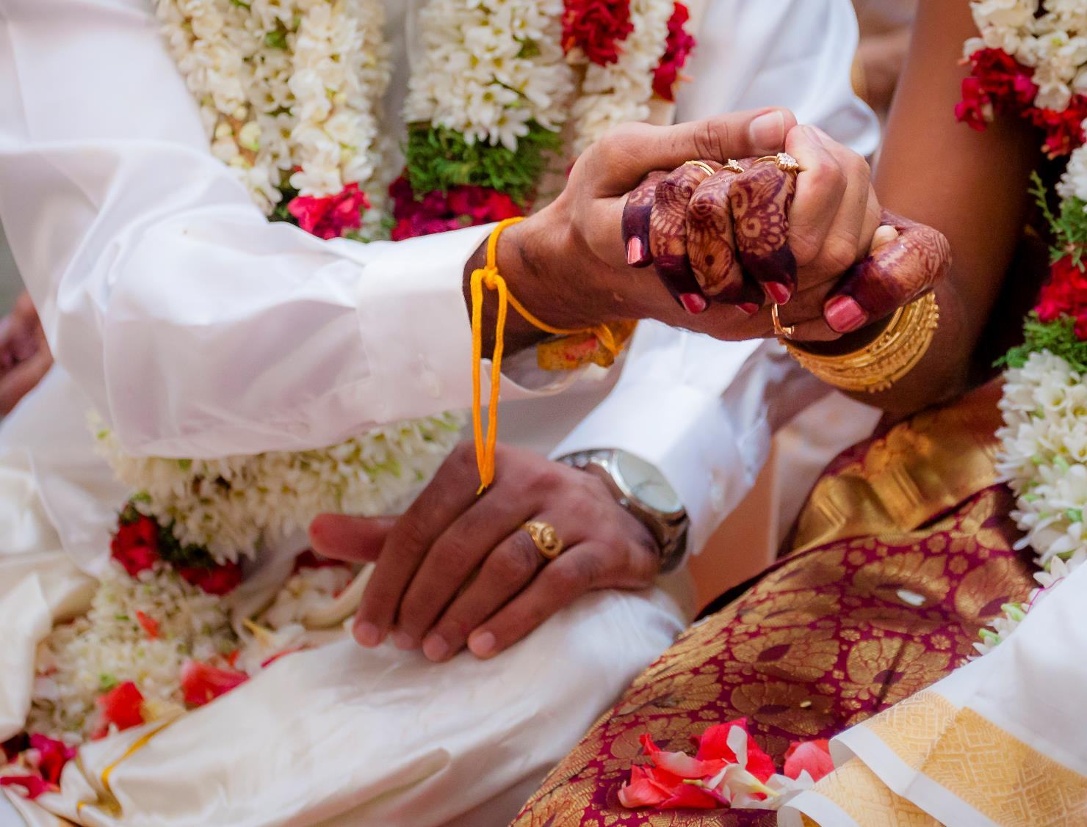
Honoring our traditions
Traditions hold a place of importance in weddings. People celebrate unions in many different, and beautiful ways.

Slide 18
Thank you
wedding of
The
and
Mira Persson
for joining us in celebration
Kalle Astrom

Slide 19
Divider Option 1
wedding of
The
and
Mira Persson
Kalle Astrom

Slide 20
Divider Option 2
Mira Persson
Kalle Astrom

